Slide 1
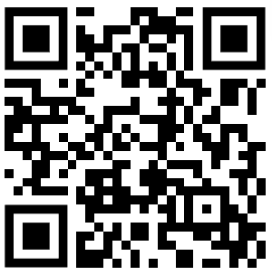


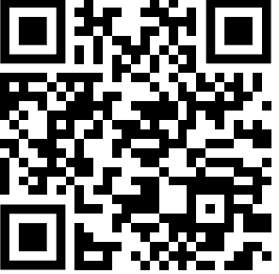


PRE SURVEY
Notes:
Welcome to GBM 1
Take notes bc lot of information
Name, Major
President for 2023-2024

Slide 2

HISTORY
Notes:
Go over history for those who are new

Slide 3
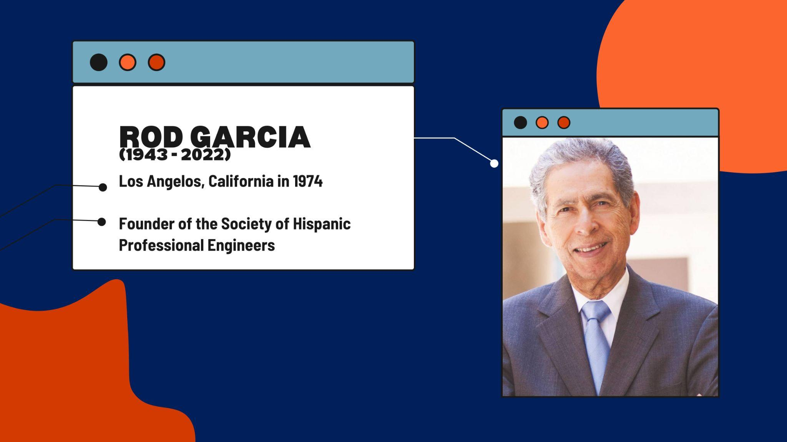
OUR FOUNDER
Notes:
Dominic

Slide 4
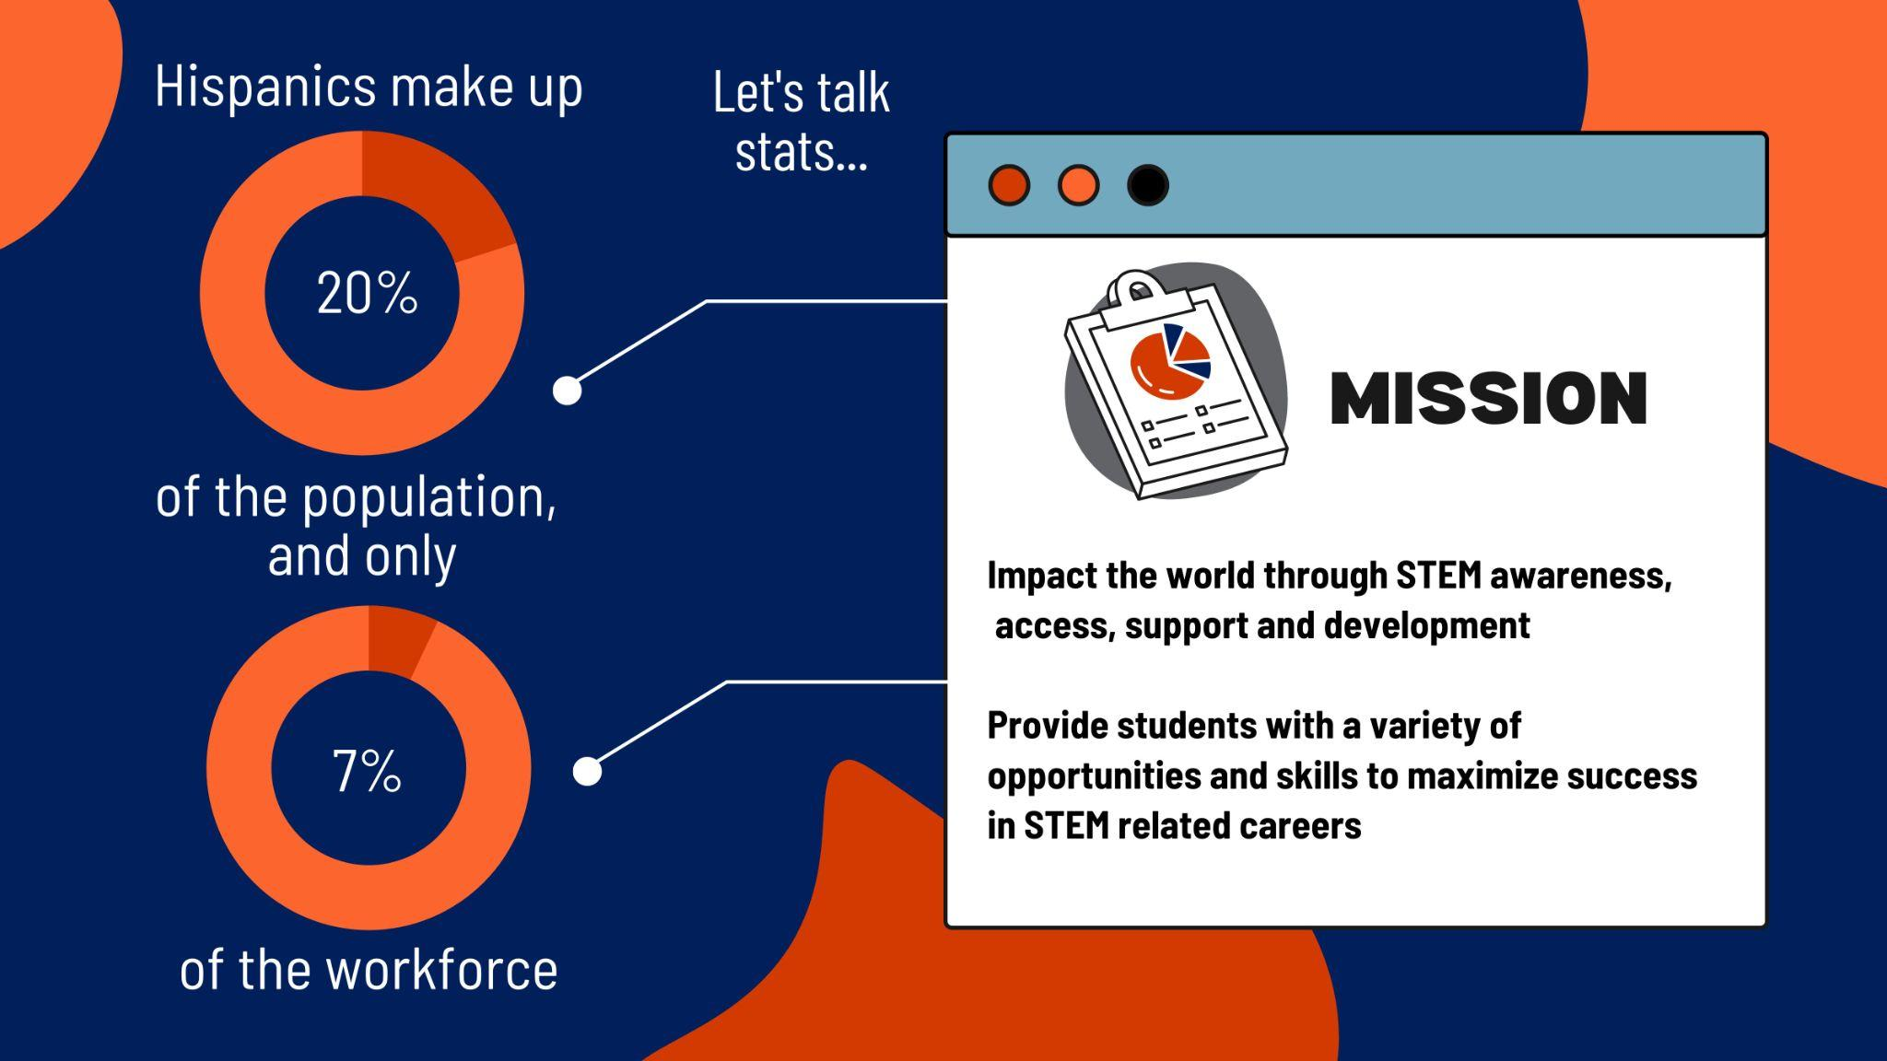
Notes:
Dominic

Slide 5

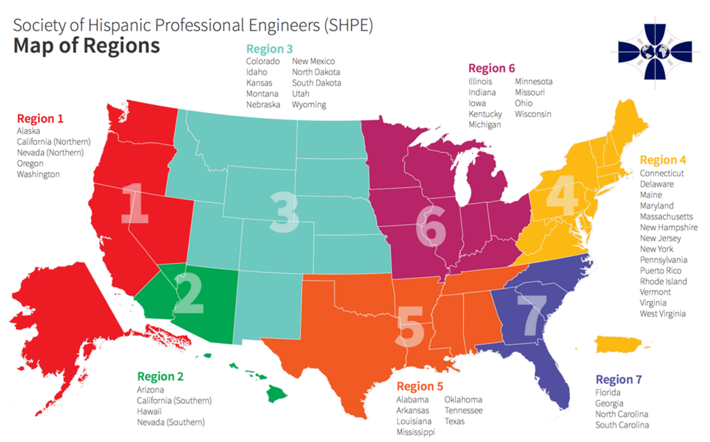
REGIONAL MAP
Region 7
Con la Región Siete. ¡Nadie se mete!
Notes:
Dominic

Slide 6

EVENT ANNOUNCEMENTS

Slide 7
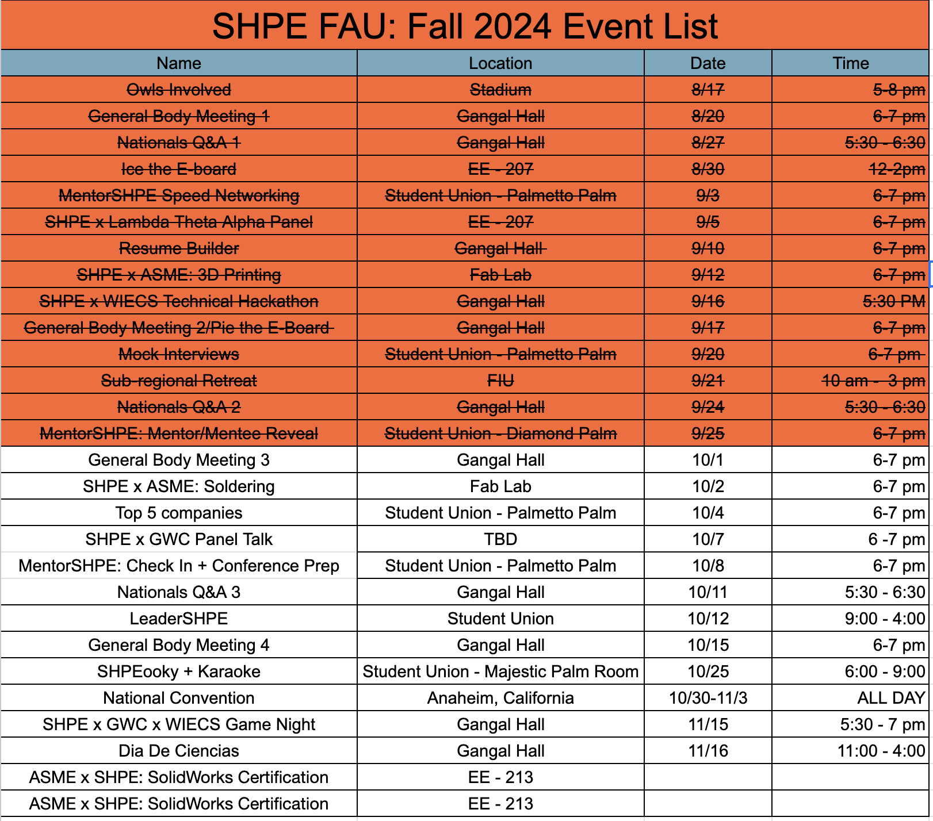

Slide 8


SHPE x ASME: Soldering Workshop
October 2nd, 2024
6 - 7 pm
Engineering East - Fab Lab
Learn and practice essential soldering techniques used in various engineering and electronics projects. Whether you're new to soldering or looking to improve your skills, this workshop will offer guided instruction and demonstrations
All skill levels are welcome!
Notes:
TANIA

Slide 9

Top 5 Companies
October 4th, 2024
6 - 7 pm
Student Union: Palmetto Palm
Designed to help students strategically identify the top 5 companies they should target at the upcoming SHPE National Convention.
Receive tips on researching companies, refining their job search, and preparing for networking opportunities at the convention!
Notes:
TANIA

Slide 10










LEADERSHPE
October 12, 2024 10:00am-4:00pm Student Union
Mock Interviews Resume Critiques
Professional Closet Access
Networking
Presentations National Convention: Do’s and Don’t
Professional Guest Speaker
Professional Guest Speaker
Notes:
NEAL

Slide 11






SHPEooky & Karaoke
October 15, 2024
6 - 9 pm
Student Union - Live Oak
Come join us for a night of fun with karaoke and a costume contest.
Dust off your costumes and warm up your vocal cords for a spooktacular evening with SHPE! Join us for our "SHPEooky + Karaoke" night, where Halloween meets harmony in an unforgettable celebration. Whether you're coming to belt out your favorite tunes or just to cheer on your friends, it’s the perfect way to show your spirit—both Halloween and SHPE!
Notes:
TANIA

Slide 12
NATIONAL CONVENTION
Notes:
Ethan

Slide 13



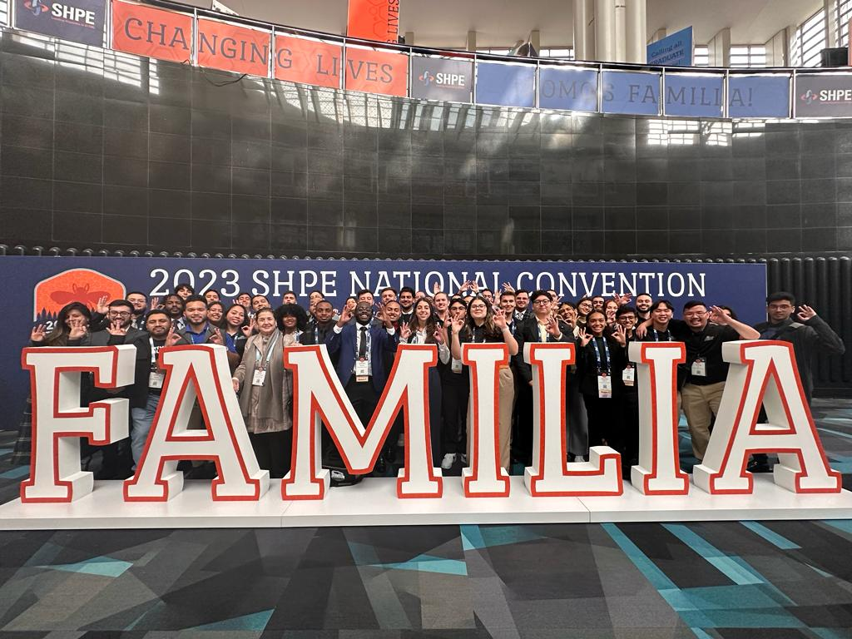
CONVENTION DETAILS
October 30th - November 3rd
Anaheim, California
Member Prices (now - Oct. 16th)
Members: $325
Non-Members: $499
Late Prices (Oct. 17th - onsite)
Members: $525
Non-Members: $599
Five Distinct Conferences: Pre-College, Academic, SHPEtinas, Professionals in STEM, and SHPETech
Notes:
Ethan

Slide 14




















CAREER FAIR & GRAD SCHOOL EXPO
Notes:
Ethan

Slide 15

CONVENTION BENEFITS
290+ sponsors and exhibitors hiring leading Hispanics in STEM
100+ onsite skill-building workshops
7 regional meetups and networking time
6 in-person, interactive networking events
5 signature events celebrating the Familia
5 challenging, fast-paced competitions
2 days at the onsite Career Fair & Graduate School Expo
4 days of onsite interviews with leading organizations
1 closing celebration party open to all attendees
Notes:
Ethan

Slide 16
ALUMNI GRANT FOR UNDERGRADUATE MEMBERS
WIN A TRIP TO NATIONALS!
Award: Registration fee coverance ($200)
How to Earn Points:
Event Attendance (Pre- and Post-Announcement):
Attended Event + Filled Both Pre and Post Survey: 10 points
Attended Event + Only Pre or Post Survey: 7 points
Attended Event but No Survey: 5 points
Bonus Points for Early Engagement (Before the Announcement):
Attended 3+ Events Before Announcement: 15 bonus points
Attended 1-2 Events Before Announcement: 10 bonus points
Additional Engagement:
Shared Event on Social Media: 5 points
Brought a New Member to an Event: 10 points
Requirements:
Must be an undergraduate student!
Must be attending National Convention in-person!
Must be in the one of the top point earners!
Notes:
Ethan

Slide 17

NC Q&A SESSIONS
Still have questions regarding registration or national convention? Join us for our Q&A.
Still have questions? Join our Q&A Session
October 11th, 2024
Engineering East
5:30pm - 6:30pm
Google Meets Link will be provided sooner to the date
Notes:
Ethan

Slide 18


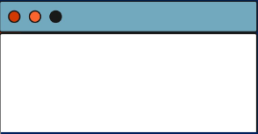

OWL CENTRAL
SHPE CONNECT
Go to SHPE on Owl Central
Click "Sign In" on the top- right corner, using your FAU Net ID and Password
Click “Join”
Click “Confirm”
Note: For exact steps, scan the QR code.
Undergraduate Membership: $10
Graduate Membership: $15
Login to existing account or create a new account on www.shpeconnect.org
Click on Join Membership.
Select Member Type ( Example: Undergraduate) , add selection to your shopping cart.
Select Region and Chapter Name (Region: 7, Chapter: Florida Atlantic University ), add to your cart.
Proceed to checkout to complete payment.
WHATSAPP + NEW MEMBER FORM
Notes:
Neal

Slide 19


FREE STOLES
Blue: Undergraduate Students
Black: Graduate Students
Requirements:
Must be enrolled on Owl Central
Must be enrolled on SHPE Connect for the 2024-2025 year
Attend all four General Body Meetings
Attend LeaderSHPE
Notes:
Tania

Slide 20
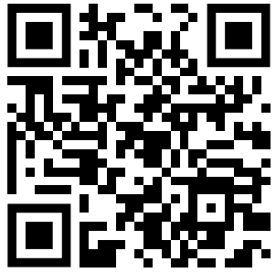
Breakout Time!
POST SURVEY
Notes:
Ethan

